Slide 1
Diia is a digital services ecosystem of the government of Ukraine, comprising a mobile app and a web portal. The information presented here was gleaned from this post: https://www.itworldcanada.com/article/diia-ukraine-implements-world-leading-digital-government-in-the-middle-of-a-war-whats-our-excuse/502597 and this video: https://www.youtube.com/watch?v=I2t6WrYyt5I
UX of Diia
Presented at IIW XXXVI
on April 18, 2023
Francisco Corella
fcorella@pomcor.com

Slide 9
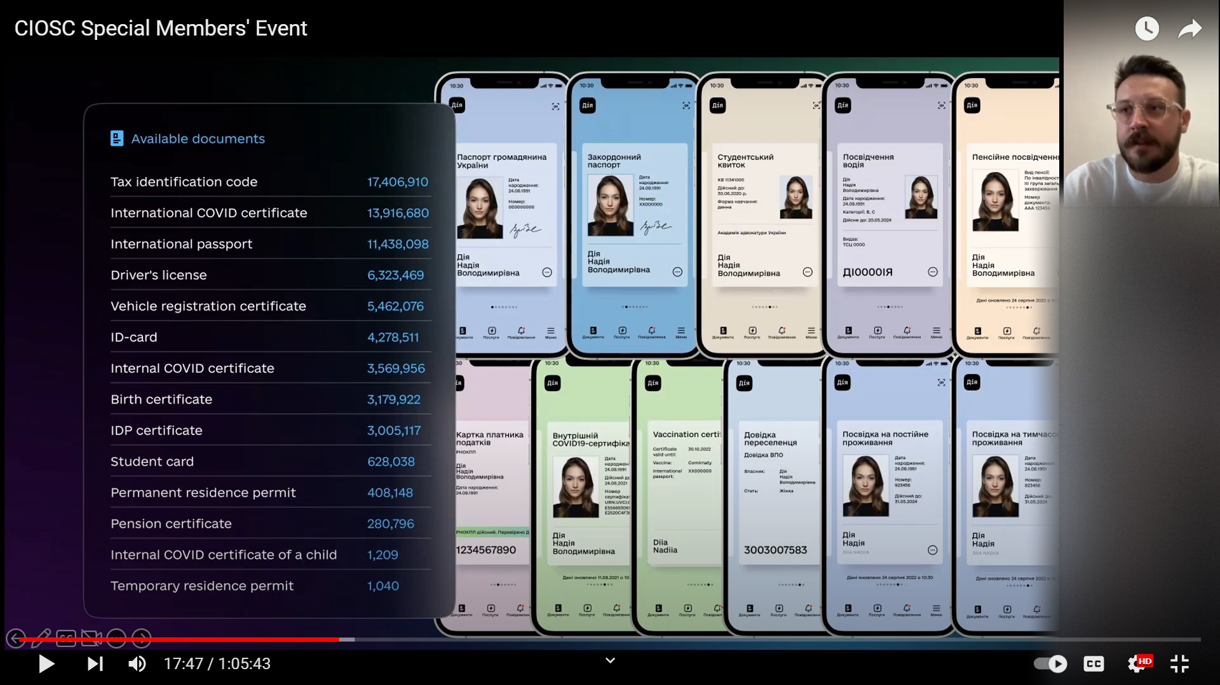

Slide 12
A QR code is displayed by the app and scanned by the relying party, rather than the reverse. This is how it should be, according to user testing reported at IIW XXXV by Sukhi Chuhan

Slide 13
Document sharing
By showing the QR code, the user authorizes the party that scans the code to access the document
The code remains valid for 3 minutes
The document is not in the phone, it’s in whatever registry it belongs to
The code is a deep link to the document within the registry

Slide 14
Not allowed

Slide 15
Seeing vs retrieving the document
The party scanning the QR code may ask to have the document retrieved into its backend
The government allows some parties to retrieve some documents
If a party requests retrieval of a document that it is not authorized to retrieve, an error is displayed on the user’s phone
If a document is successfully retrieved, it is “validated in Diia via in-app scanner” (???)
Note: the above was not clear in the presentation and may be wrong

Slide 17
Before the document is shared, this shows who is asking for what document, and the user is asked for consent to share it

Slide 18
Face recognition with liveness detection

Slide 19
PIN

Slide 20
???

Slide 24
This really means authentication

Slide 25
The signature seems to be computed by the backend, according to the next slide

Slide 27
Authentication before app setup

Slide 29
QTSP = Qualified Trust Service Provider
(EU terminology)

Slide 30
Presumably the app will send this part back later, when a signature needs to be computed

