Slide 1
A driver’s license credential usable for website registration and traffic stops
Presentation at IIW XLI, by
Francisco Corella
fcorella@pomcor.com
Joint work with
Sukhi Chuhan, Pema Selden and Veronica Wojnas
October 2025

Slide 2
Our project
This is the first result of an ambitious project that intends to demonstrate with working code:
Issuance of a credential in multiple formats with the same certified attributes, such as:
Full and selective disclosure JSON certificates
Verifiable credentials with did:key subject identifiers
ZK credentials based on CL and BBS signatures
Using the browser as a wallet, with credentials kept in localStorage, IndexedDB storage, and the WebAuthn platform authenticator
Credential presentation by a Service Worker that intercepts a request addressed to the issuer and creates a consent page
CAVEAT: Does not work with Firefox
Automated replication of credentials to multiple devices operated by the same user, relying on a replication passkey for authentication

Slide 3
Bhutan NDI theme
Servers in the demo will play the role of entities in the Bhutan National Digital Identity (NDI) system, such as the Road Safety and Transportation Authority (RSTA) or the Verifiable Data Registry (VDR).
DISCLAIMER: Our implementation of those servers does not resemble the current implementation of the corresponding Bhutan entities.

Slide 4
This demonstration
In this demo, a driver’s license credential is issued as a full disclosure JSON certificate and as a selective disclosure JSON certificate
The credential is issued after the driver scans a QR code shown at the RSTA office after passing the driver’s exam
The selective disclosure format if used for registration to a website
The full disclosure format is used for presentation to a traffic police officer who displays a QR code
NOTE: the selective disclosure format could be used instead with disclosure of all attributes; but the full disclosure format may be preferred instead by the RP for simplicity of implementation

Slide 5
Part I: Issuance

Slide 6

RSTA office
RSTA data center
Internal
Server
Edge
Server
Private
network
QR
Internet
Browser
Browser
Administrator
Driver in RSTA office after passing exam

Slide 7
RSTA office
RSTA data center
Internal
Server
Edge
Server
Private
network
v4-ci-admin.pomcor.com
v4-ci.pomcor.com
QR
Internet
Browser
Broswser
This is v4 of the demo; features coming in v5 are mentioned below
Administrator
Driver in RSTA office passing exam

Slide 8
RSTA office
RSTA data center
Driver record
Edge
Server
Private
network
Validated
attributes
QR
Internet
Browser
Browser
Attributes
Administrator
Driver in RSTA office passing exam

Slide 9
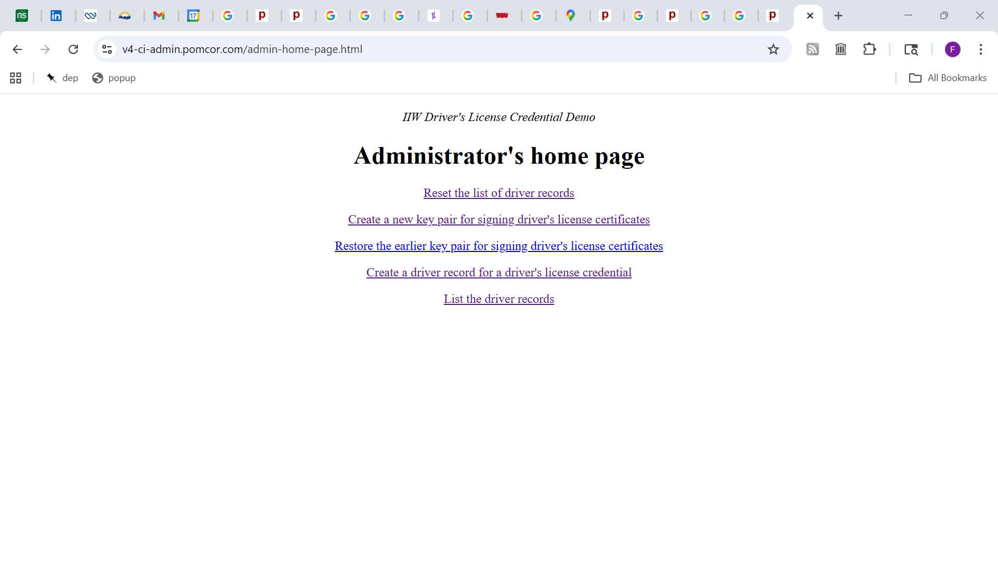
v4-ci-admin.pomcor.com

Slide 11
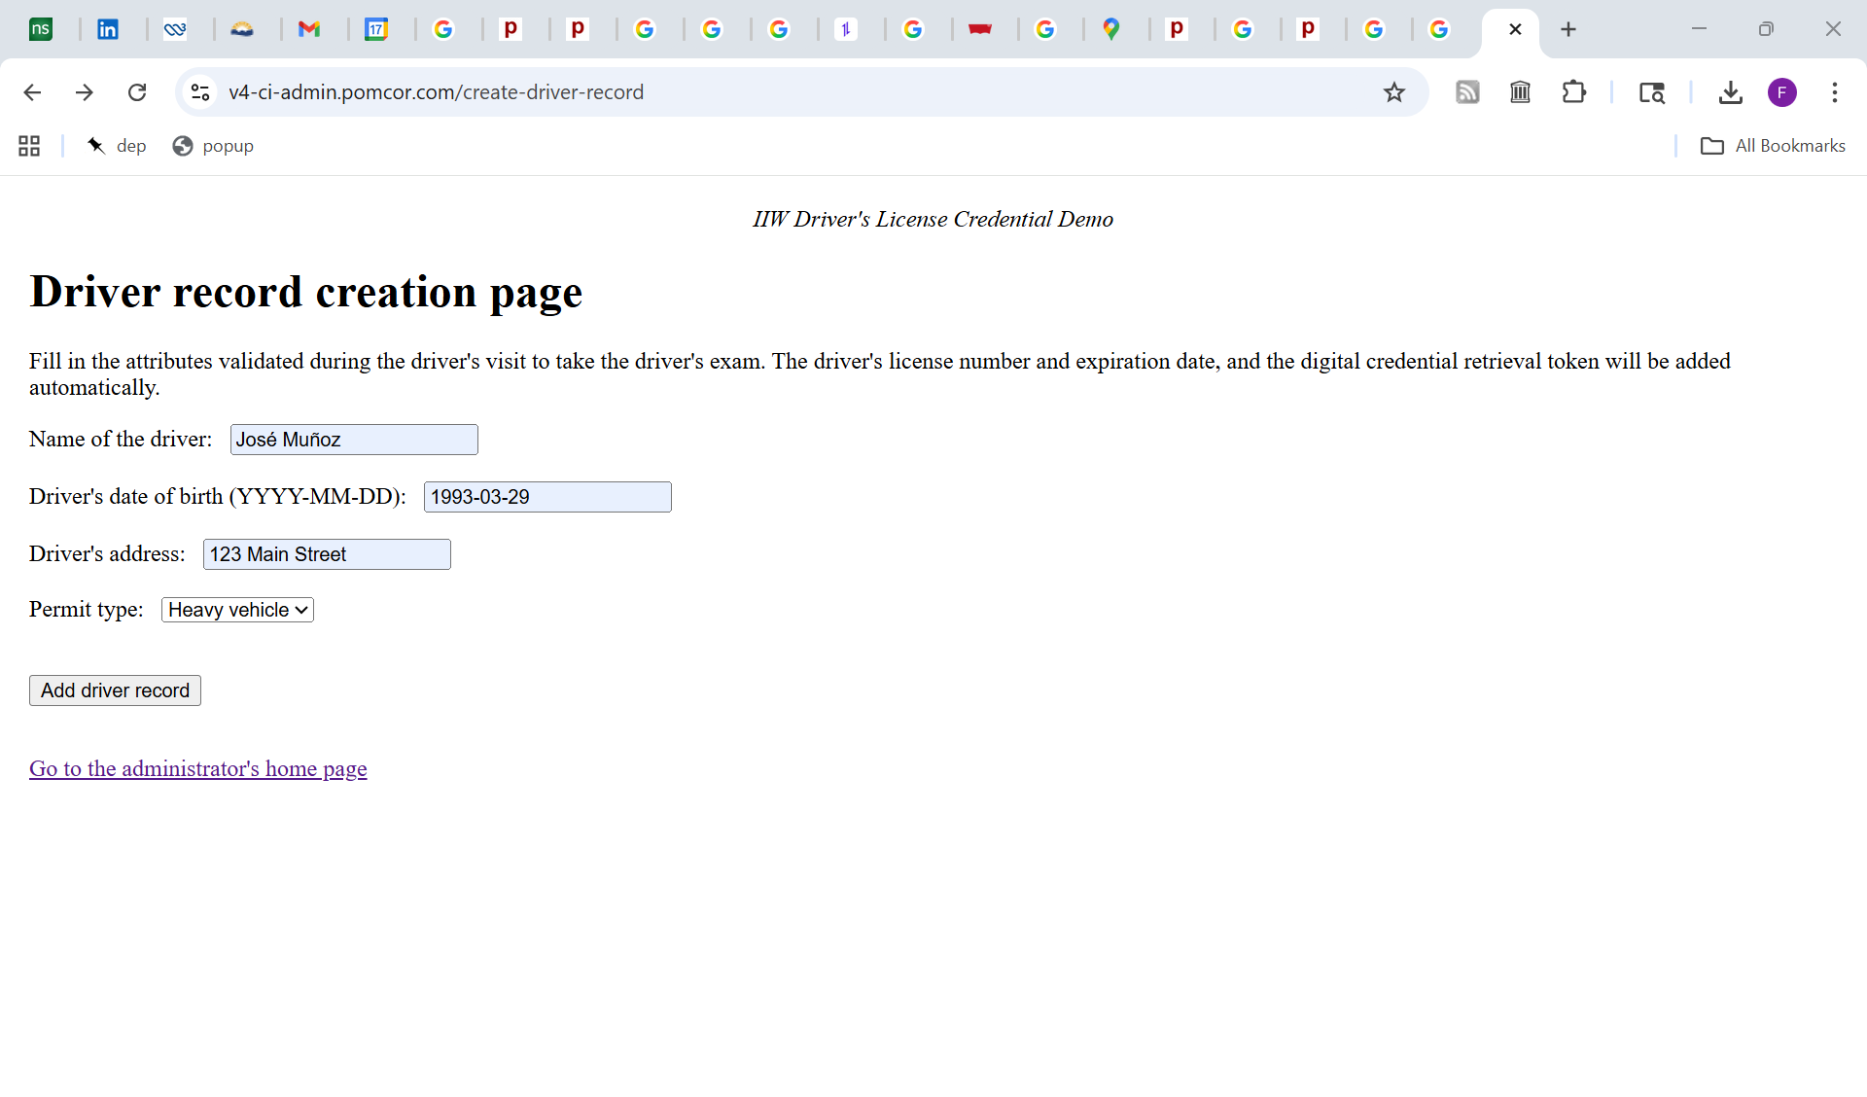

Slide 12
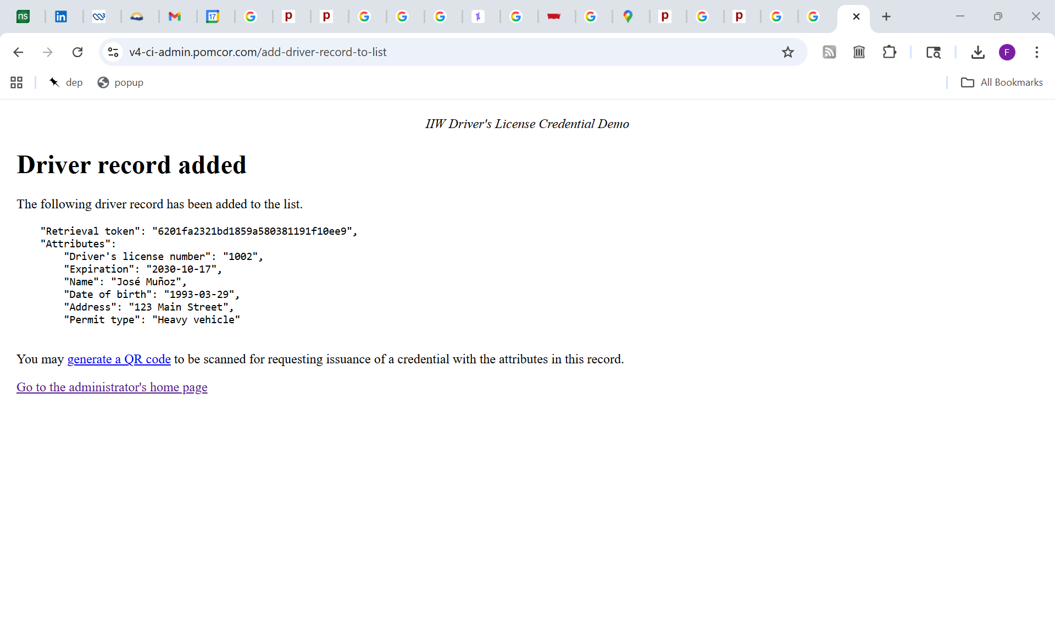

Slide 15
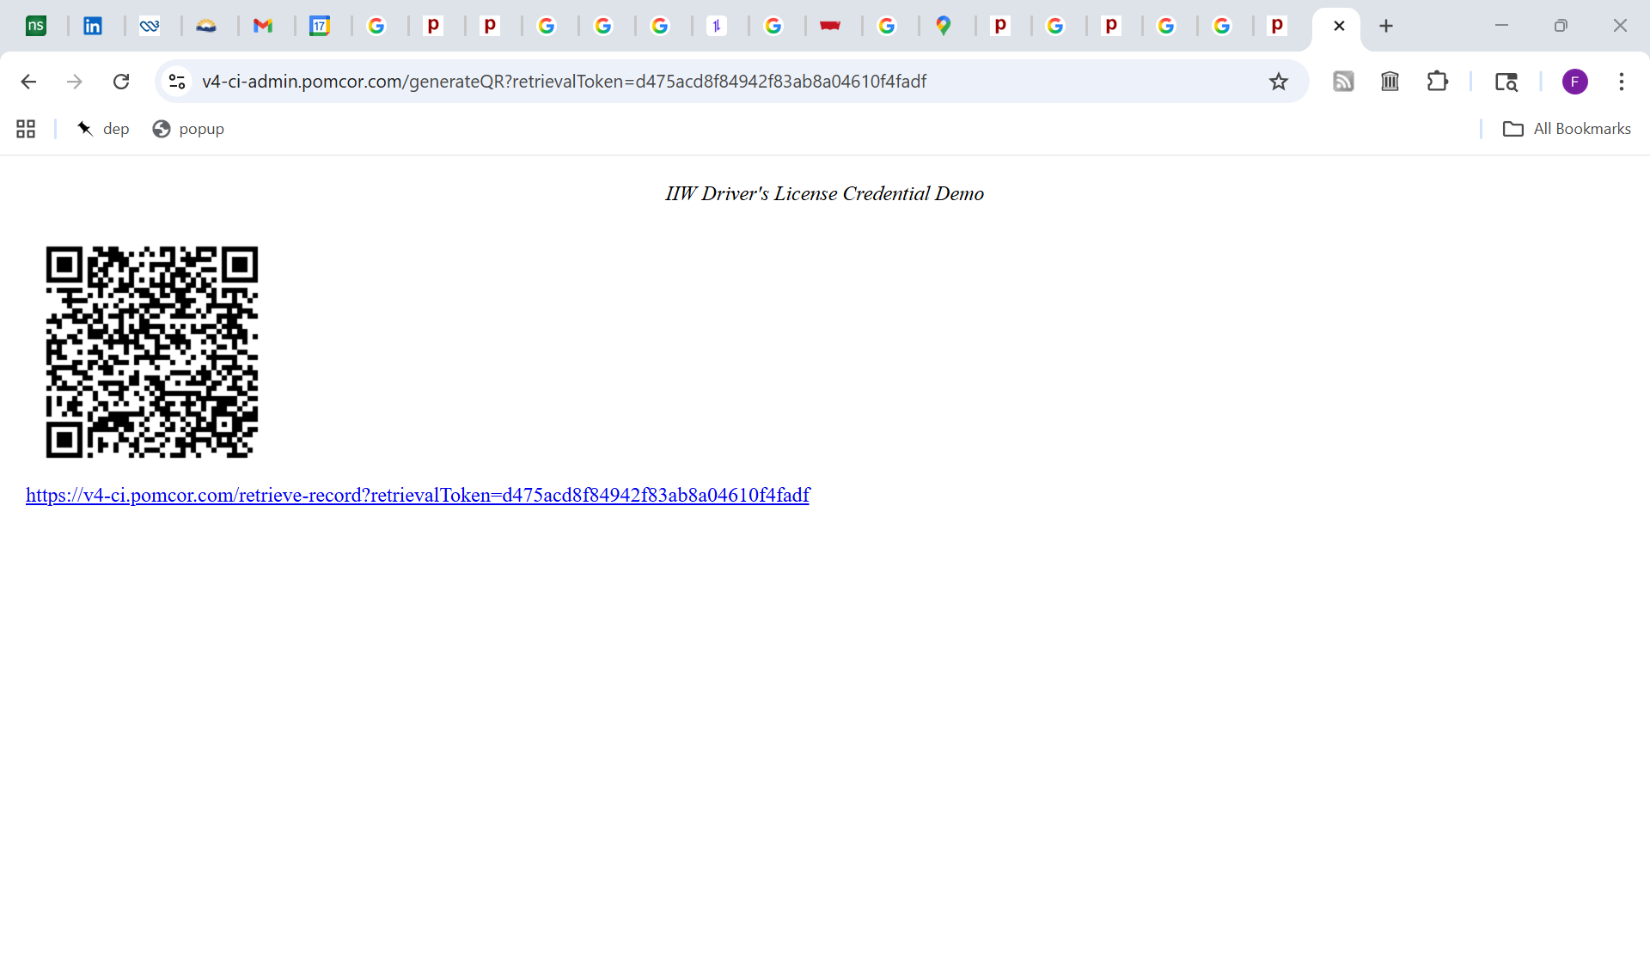
URL requesting driver record, which has the attributes

Slide 16
RSTA office
RSTA data center
Internal
Server
Edge
Server
Private
network
URL requesting the attributes
QR
Browser
Broswser
Administrator
Driver in RSTA office passing exam

Slide 17
RSTA office
RSTA data center
Internal
Server
Edge
Server
Private
network
URL requesting the attributes
QR
URL requesting the attributes
Browser
Broswser
Administrator
Driver in RSTA office passing exam

Slide 18
RSTA office
RSTA data center
Internal
Server
Edge
Server
Private
network
URL requesting the attributes
QR
URL requesting the attributes
Browser
Broswser
Request for
the attributes
Administrator
Driver in RSTA office passing exam

Slide 19
RSTA office
RSTA data center
Internal
Server
Relayed request for attributes
Edge
Server
URL requesting the attributes
QR
URL requesting the attributes
Browser
Broswser
Request for
the attributes
Administrator
Driver in RSTA office passing exam

Slide 20
RSTA office
RSTA data center
Internal
Server
Attributes
Edge
Server
Attributes
QR
Browser
Broswser
Consent to issue credential?
Administrator
Driver in RSTA office passing exam

Slide 21
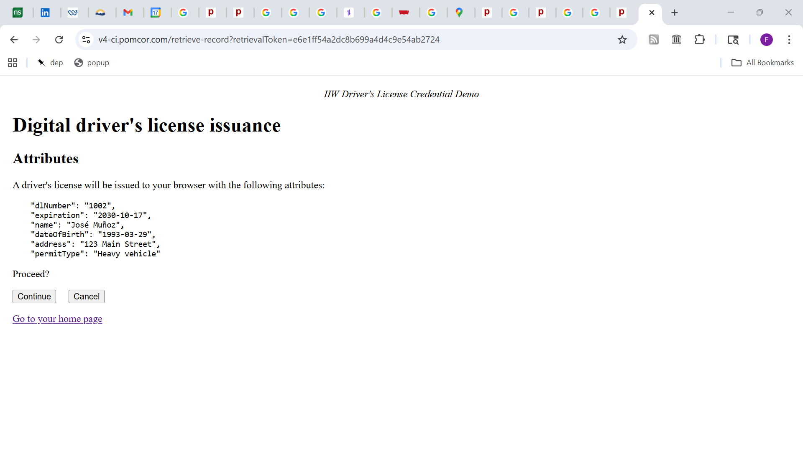

Slide 22
RSTA office
RSTA data center
Internal
Server
Edge
Server
Private
network
QR
Internet
Browser
Browser
Key pair generation
Private key signs certificate signing request (CSR) including retrieval token
Private key is stored in localStorage
Administrator

Slide 23
RSTA office
RSTA data center
Internal
Server
Edge
Server
QR
CSR
Internet
Browser
Browser
Key pair generation
Private key signs certificate signing request (CSR) including retrieval token
Private key is stored in localStorage
Administrator

Slide 24
RSTA office
RSTA data center
Internal
Server
CSR
Edge
Server
QR
CSR
Internet
Browser
Browser
Key pair generation
Private key signs certificate signing request (CSR) including retrieval token
Private key is stored in localStorage
Administrator

Slide 25
RSTA office
RSTA data center
Internal server
Verifies that CSR agrees with driver record
Constructs and signs full disclosure and selective disclosure certificates
Edge
Server
Private
network
QR
Internet
Browser
Browser
Administrator
Driver in RSTA office passing exam

Slide 26
RSTA office
RSTA data center
Internal
Server
Both certificates
Edge
Server
QR
Internet
Browser
Browser
Administrator
Driver in RSTA office passing exam

Slide 27
RSTA office
RSTA data center
Internal
Server
Both certificates
Edge
Server
Both
certificates
QR
Internet
Browser
Browser
Administrator
Driver in RSTA office passing exam

Slide 28
RSTA office
RSTA data center
Internal
Server
Edge
Server
QR
Internet
Browser
Browser
Certificates stored in localStorage, joining the private key
Service worker registered with the browser
Administrator

Slide 29
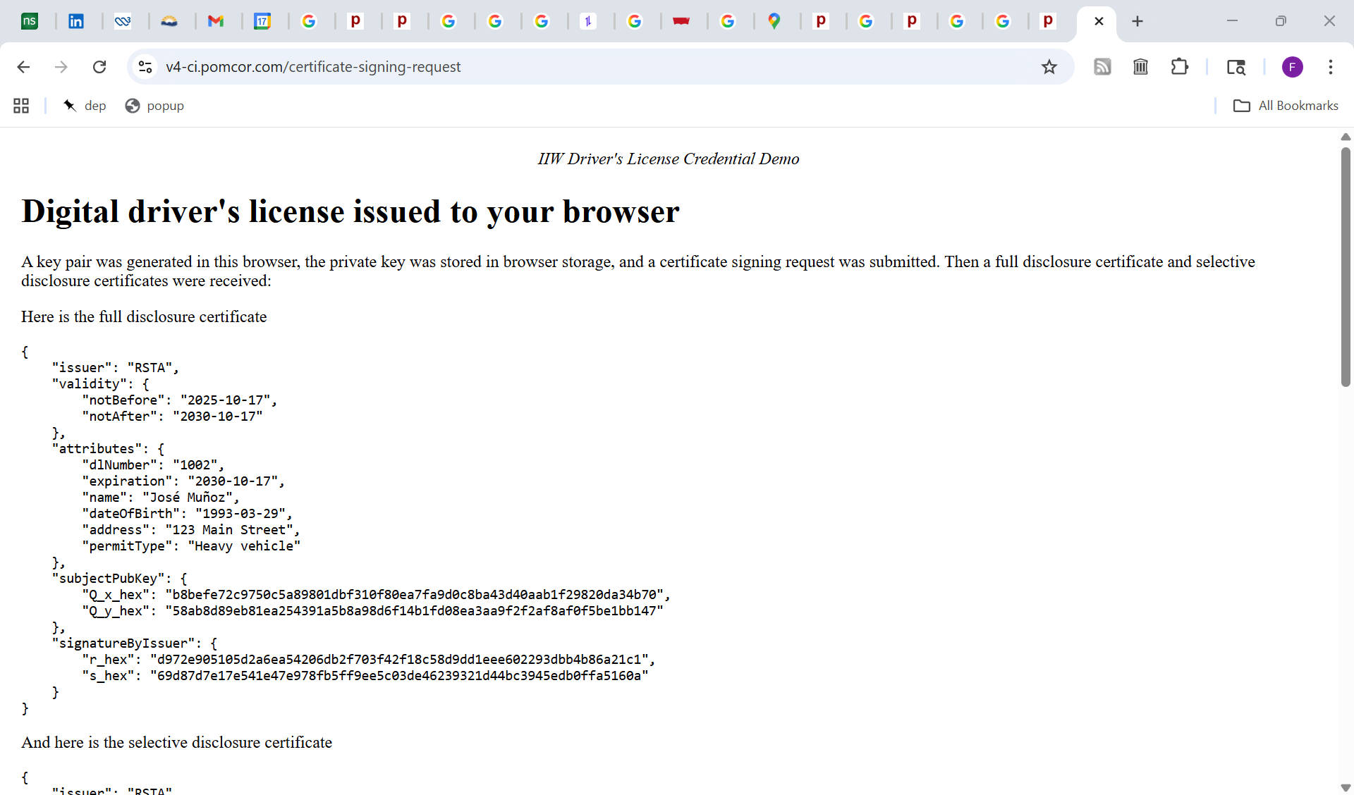

Slide 30
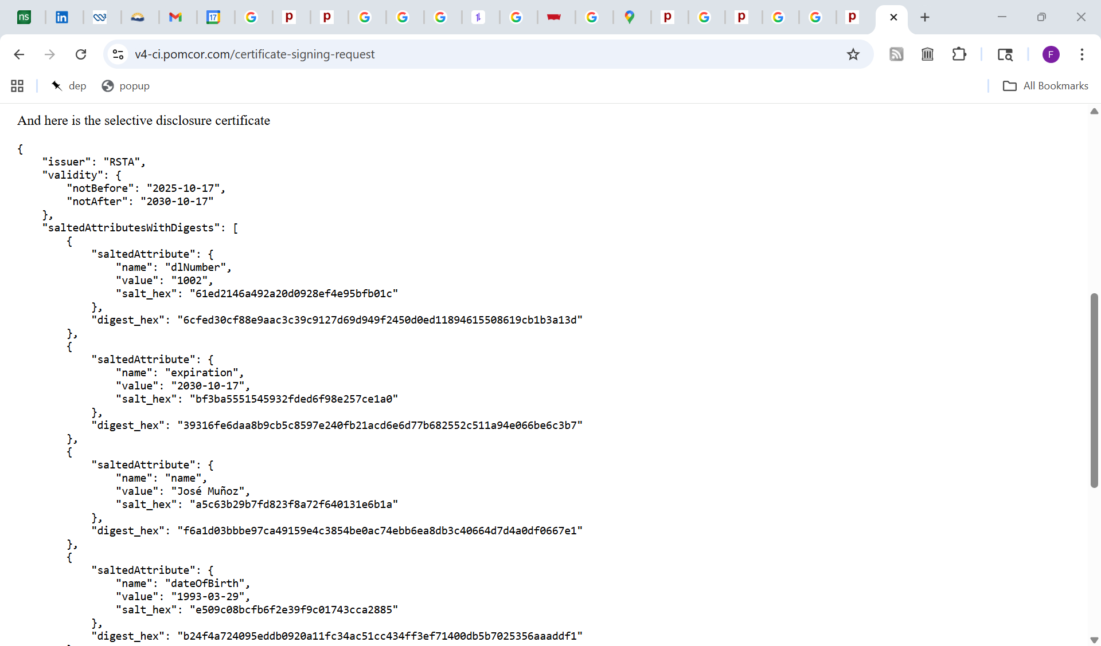
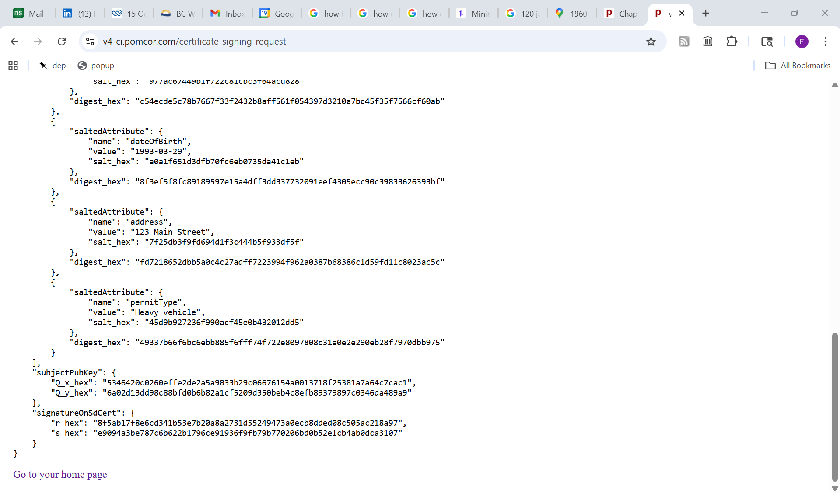

Slide 31
Part II: Presentation for website registration

Slide 32
Server playing the role of the
Bhutan Verifiable Data Registry
To be implemented in v5
Credential issuer:
the edge server of the RSTA data center
Browser
Relying party:
a website
Service
worker
localStorage
Private key
Full disclosure
JSON certificate
Selective disclosure
JSON certificate

Slide 33
Credential issuer:
the edge server of the RSTA data center
Browser
Relying party:
a website
Service
worker
v4-ci.pomcor.com
v4-rp.web.pomcor.com
Local storage
Private key
Full disclosure
JSON certificate
Selective disclosure
JSON certificate

Slide 34
Credential issuer:
the edge server of the RSTA data center
Browser
Relying party:
a website
Service
worker
User visits
v4-ci.pomcor.com
v4-rp.web.pomcor.com
Local storage
Private key
Full disclosure
JSON certificate
Selective disclosure
JSON certificate

Slide 35
Credential issuer:
the edge server of the RSTA data center
Browser
Relying party:
a website
Service
worker
Registration page
RP downloads the registration page
Local storage
Private key
Full disclosure
JSON certificate
Selective disclosure
JSON certificate

Slide 36
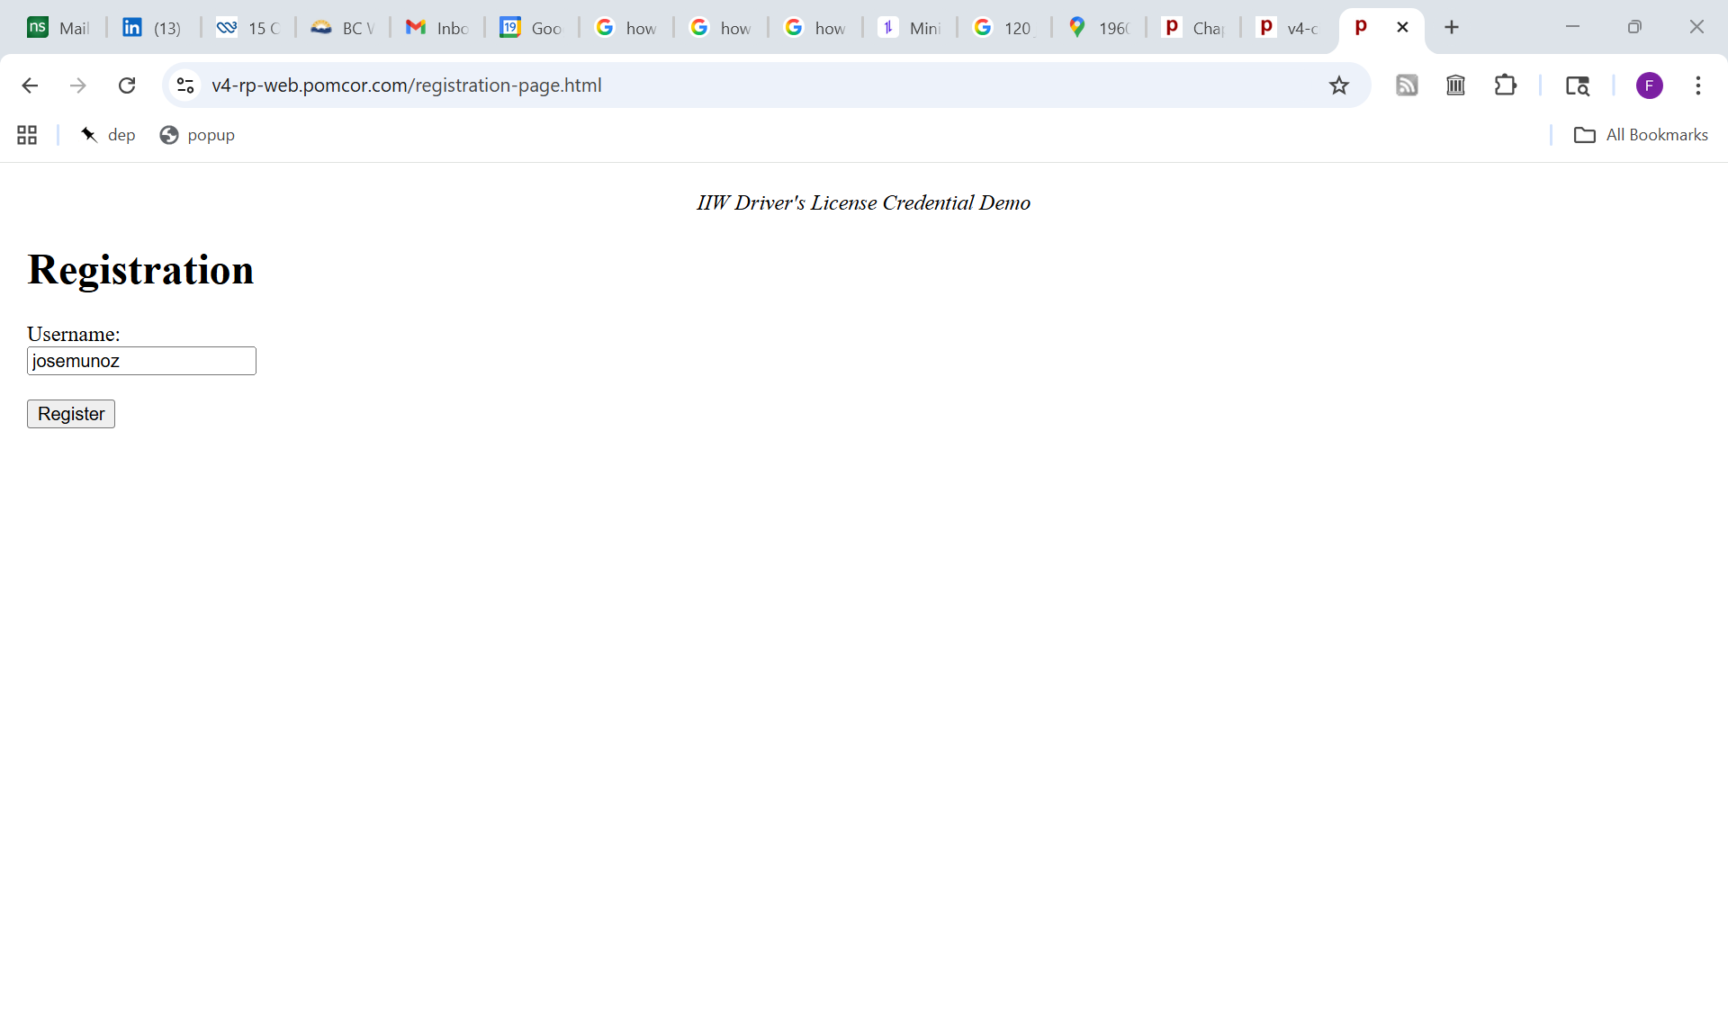

Slide 37
Credential issuer:
the edge server of the RSTA data center
Browser
Relying party:
a website
Service
worker
Registration page
username
RP creates a user record indexed by the username and a session record that references the user record
Local storage
Private key
Full disclosure
JSON certificate
Selective disclosure
JSON certificate

Slide 38
Credential issuer:
the edge server of the RSTA data center
Browser
Relying party:
a website
Service
worker
Registration page
The session record keeps track of the registration process and contains a challenge
Local storage
Private key
Full disclosure
JSON certificate
Selective disclosure
JSON certificate

Slide 39
Credential issuer:
the edge server of the RSTA data center
Browser
Relying party
Service
worker
RP performs a “POST redirection”, downloading a code-only page with hidden form that targets the request endpoint of the selective disclosure credential
JavaScript
Local storage
Private key
Full disclosure
JSON certificate
Selective disclosure
JSON certificate

Slide 40
Credential issuer:
the edge server of the RSTA data center
Browser
Relying party
Service
worker
JavaScript
Hidden fields in the form include the session ID, the desired attributes, the challenge and the URL of the callback endpoint
Local storage
Private key
Full disclosure
JSON certificate
Selective disclosure
JSON certificate

Slide 41
Credential issuer:
the edge server of the RSTA data center
Browser
Relying party:
a website
Service
worker
JavaScript
The form is automatically submitted, but the request is intercepted by the service worker
Local storage
Private key
Full disclosure
JSON certificate
Selective disclosure
JSON certificate

Slide 42
Server playing the role of the
Bhutan Verifiable Data Registry
Credential issuer:
the edge server of the RSTA data center
Browser
Relying party:
a website
Service
worker
Consent page
The service worker creates a page that will ask for consent to present the selective disclosure credential with the attributes name, date of birth and address to the relying party.
In v4, the RP is identified by the hostname in the callback URL
In v5, it will be identified by a user-friendly designation retrieved from the server playing the role of the Verifiable Data Registry
Local storage
Private key
Full disclosure
JSON certificate
Selective disclosure
JSON certificate

Slide 43
Credential issuer:
the edge server of the RSTA data center
Browser
Relying party:
a website
Service
worker
Consent page
JavaScript
Local storage
The consent page retrieves the private key and the selective disclosure certificate from localStorage
Private key
Full disclosure
JSON certificate
Selective disclosure
JSON certificate

Slide 44
Credential issuer:
the edge server of the RSTA data center
Browser
Relying party:
a website
Service
worker
Consent page
JavaScript
The consent page finds the values of the requested attributes from the selective disclosure certificate and removes the other attributes from the presentation state of the certificate
Local storage
Private key
Full disclosure
JSON certificate
Selective disclosure
JSON certificate

Slide 45
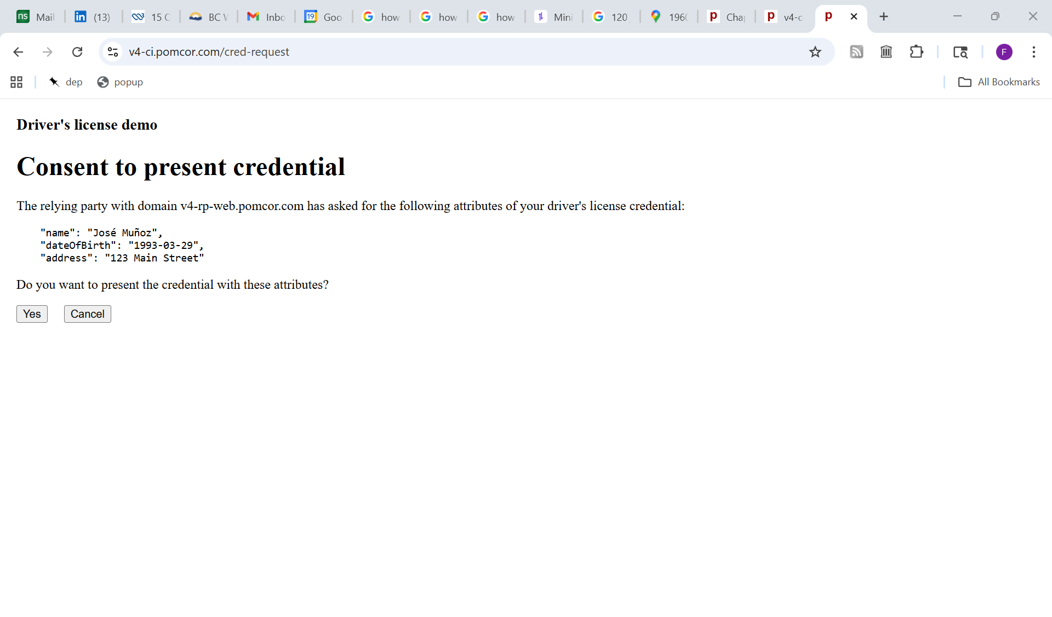
In v5, the Verifiable Data Registry will map the domain name of the RP to a user-friendly designation upon request by the consent page
The consent page has found the values of the attributes in the selective disclosure certificate

Slide 46
Credential issuer:
the edge server of the RSTA data center
Browser
Relying party:
a website
Service
worker
Consent page
JavaScript
The consent page uses the private key to compute a signature on the challenge and the callback endpoint
Local storage
Private key
Full disclosure
JSON certificate
Selective disclosure
JSON certificate

Slide 47
Credential issuer:
the edge server of the RSTA data center
Browser
Relying party:
a website
Service
worker
Consent page
JavaScript
The consent page sends the signature, the presentation state and the session ID to the callback endpoint
Local storage
Private key
Full disclosure
JSON certificate
Selective disclosure
JSON certificate

Slide 48
Credential issuer:
the edge server of the RSTA data center
Browser
Relying party:
a website
Service
worker
Consent page
The consent page validates the proof of possession by using the public key in the certificate to verify the signature on the challenge and the callback endpoint
JavaScript
Local storage
Private key
Full disclosure
JSON certificate
Selective disclosure
JSON certificate

Slide 49
Server playing the role of the
Bhutan Verifiable Data Registry
Public key
of the issuer
Credential issuer:
the edge server of the RSTA data center
Browser
Relying party:
a website
Service
worker
Consent page
In v5, the consent page will validate the certificate using public key of the issuer retrieved from the server playing the role of the Verifiable Data Registry
JavaScript
Local storage
Private key
Full disclosure
JSON certificate
Selective disclosure
JSON certificate

Slide 50
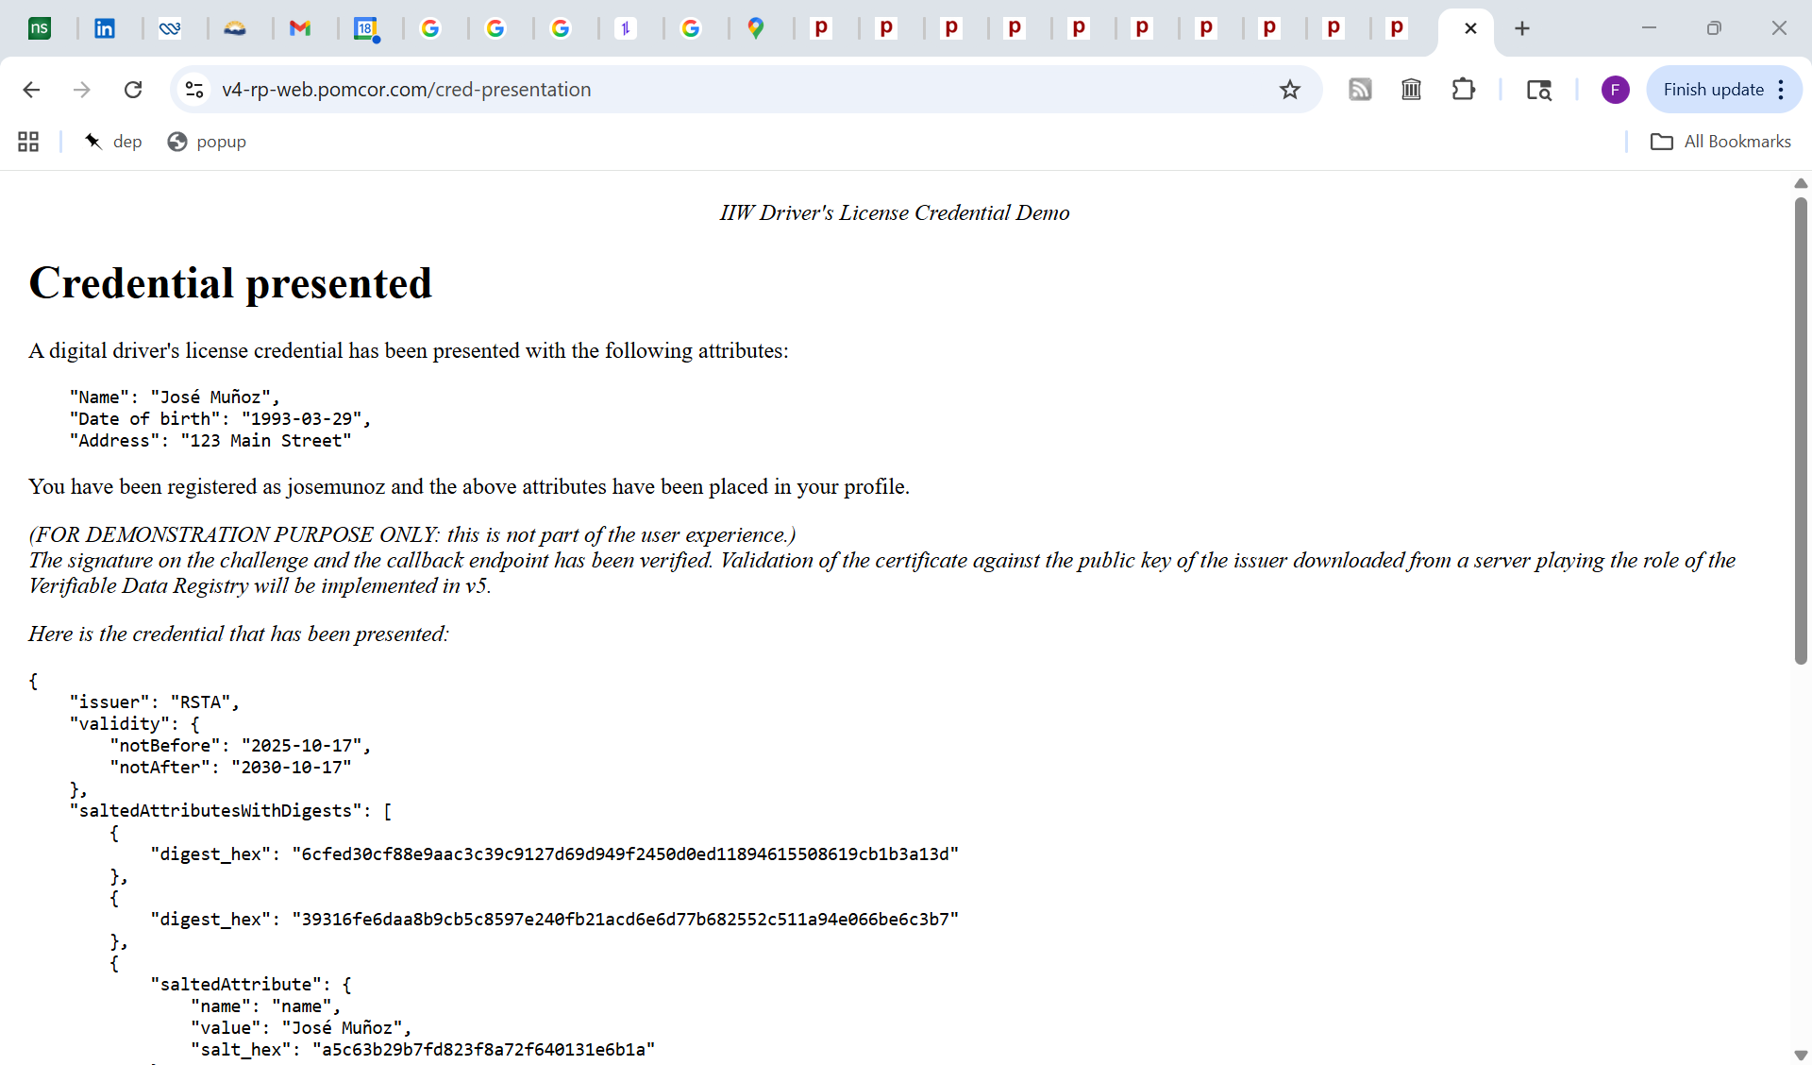

Slide 51
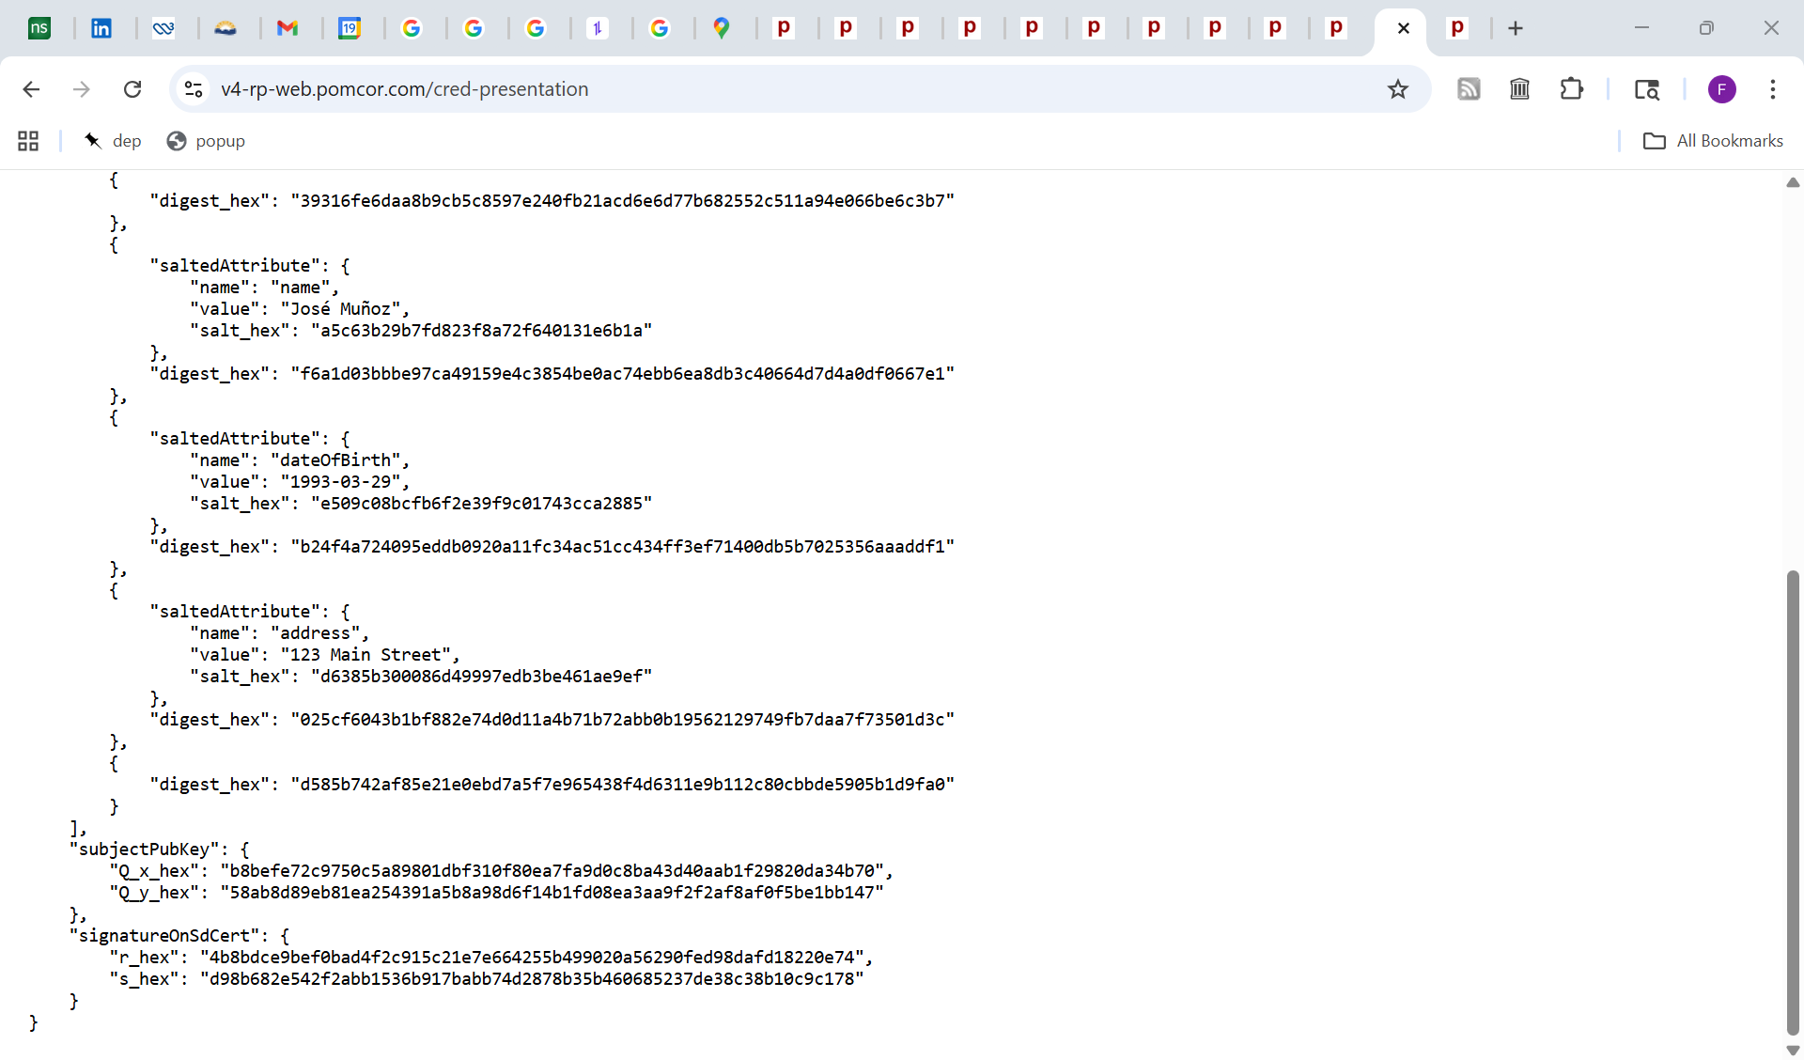

Slide 52
Part III: Presentation at a traffic stop

Slide 53
Police officer
Browser in officer’s laptop or
patrol car equipment
Credential issuer:
the edge server of the RSTA data center
Relying party:
server supporting the fleet of patrol cars
Officer visits
Browser
Service
worker
v4-ci.pomcor.com
v4-rp-qr.pomcor.com
localStorage
Private key
Full disclosure
JSON certificate
Selective disclosure
JSON certificate
Driver

Slide 54
Police officer
Browser in officer’s laptop or
patrol car equipment
Credential issuer:
the edge server of the RSTA data center
Relying party:
server supporting the fleet of patrol cars
Browser
Service
worker
RP creates a session record containing a challenge. (The callback endpoint is added later in the process.)
localStorage
Private key
Full disclosure
JSON certificate
Selective disclosure
JSON certificate
Driver

Slide 55
Police officer
QR code
Polling script
Credential issuer:
the edge server of the RSTA data center
Relying party:
server supporting the fleet of patrol cars
Browser
Service
worker
RP downloads a QR code that encodes the URL of a GET request that targets a redirection endpoint of the RP and includes the challenge and the session ID as parameters
localStorage
Private key
Full disclosure
JSON certificate
Selective disclosure
JSON certificate
Driver

Slide 56
Police officer
Polling script
QR code
Credential issuer:
the edge server of the RSTA data center
Relying party:
server supporting the fleet of patrol cars
Browser
Service
worker
Driver’s browser scans the QR code and sends the GET request
localStorage
Private key
Full disclosure
JSON certificate
Selective disclosure
JSON certificate
Driver

Slide 57
Police officer
Polling script
QR code
Credential issuer:
the edge server of the RSTA data center
Server supporting the fleet of patrol cars
Service
worker
JavaScript
RP performs a “POST redirection”, downloading a code-only page with a hidden form that targets the request endpoint of the full disclosure credential and includes the session Id parameters of the GET request plus the callback endpoint of the RP
localStorage
Private key
Full disclosure
JSON certificate
Selective disclosure
JSON certificate
Driver

Slide 58
Police officer
Polling script
QR code
Credential issuer:
the edge server of the RSTA data center
Relying party: server supporting the fleet of patrol cars
Service
worker
JavaScript
The POST request is automatically submitted, but is intercepted by the service worker
localStorage
Private key
Full disclosure
JSON certificate
Selective disclosure
JSON certificate
Driver

Slide 59
Police officer
Polling script
QR code
Credential issuer:
the edge server of the RSTA data center
Relying party: server supporting the fleet of patrol cars
Service
worker
Consent page
The service worker creates a page that asks for consent to present the full disclosure credential.
In v4, the RP is identified by the hostname in the callback URL
In v5, it will be identified by a user-friendly designation retrieved from the server playing the role of the Verifiable Data Registry
localStorage
Private key
Full disclosure
JSON certificate
Selective disclosure
JSON certificate

Slide 60
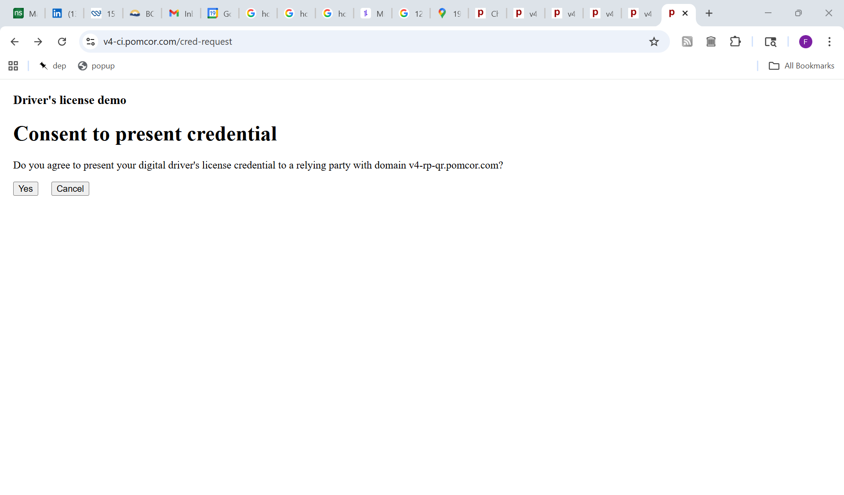
In v5, the Verifiable Data Registry will map the domain name of the RP to a user-friendly designation upon request by the consent page

Slide 61
Police officer
QR code
Polling script
Credential issuer:
the edge server of the RSTA data center
Relying party:
server supporting the fleet of patrol cars
Service
worker
Consent page
localStorage
Private key
Full disclosure
JSON certificate
The consent page retrieves the private key and the full disclosure certificate from localStorage
Selective disclosure
JSON certificate

Slide 62
Police officer
QR code
Polling script
Credential issuer:
the edge server of the RSTA data center
Relying party:
server supporting the fleet of patrol cars
Service
worker
Consent page
localStorage
The consent page uses the private key to compute a signature on the challenge and the callback endpoint
Private key
Full disclosure
JSON certificate
Selective disclosure
JSON certificate
Driver

Slide 63
Police officer
QR code
Polling script
Credential issuer:
the edge server of the RSTA data center
Relying party:
server supporting the fleet of patrol cars
Service
worker
Consent page
The consent page sends the signature and the session ID to the callback endpoint
localStorage
Private key
Full disclosure
JSON certificate
Selective disclosure
JSON certificate
Driver

Slide 64
Police officer
QR code
Polling script
Credential issuer:
the edge server of the RSTA data center
Relying party:
server supporting the fleet of patrol cars
Service
worker
Consent page
The relying party validates the proof of possession by using the public key in the certificate to verify the signature on the challenge and the callback endpoint
localStorage
Private key
Full disclosure
JSON certificate
Selective disclosure
JSON certificate
Driver

Slide 65
Police officer
Server playing the role of the
Bhutan Verifiable Data Registry
Public key of the issuer
QR code
Polling script
Credential issuer:
the edge server of the RSTA data center
Relying party:
server supporting the fleet of patrol cars
Service
worker
Consent page
In v5, the relying party will validate the certificate using public key of the issuer retrieved from the server playing the role of the Verifiable Data Registry
localStorage
Private key
Full disclosure
JSON certificate
Selective disclosure
JSON certificate
Driver

Slide 66
Notification to the driver and the officer
Upon successful validation of the proof of possession:
The RP notifies the driver in response to the credential submission, on the browser used to scan the QR code, as shown in the next screenshot.
The RP also records the full disclosure certificate in the session record. This is detected by the polling script, which displays the certificate on the officer`s equipment, e.g. on the browser in the officer’s laptop, as shown in the last screenshot. In v5, this will be extended to include successful validation of the certificate using the public key in the Verifiable Data Registry.

Slide 67
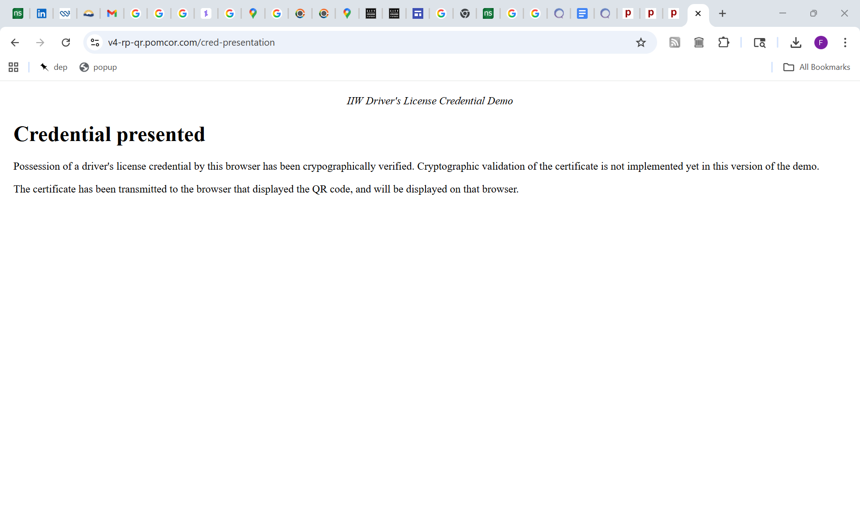

Slide 68
